Slide 1
Lecture - 17 Analog to digital conversion
Reference: chapter 7 (Mazidi)

Slide 2
Microcontroller Connection to Sensor via ADC
Notes:
ADC are widely used for data acquisition
Physical quantity is converted into electrical signal using transducers or sensors
Output is analog value so we have to convert it into digital in order to process it

Slide 3
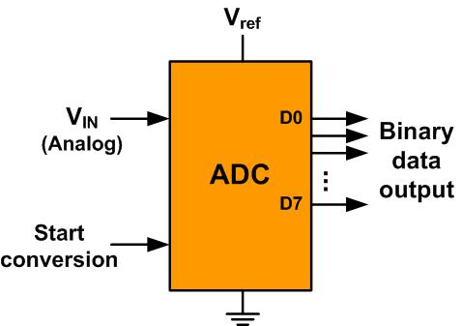
An 8-bit ADC Block Diagram
Notes:
General diagram of an ADC chip or module
It has start conversion switch
Input channel
Vref
Ground
Output (parallel/ serial)

Slide 4
Resolution versus Step Size for ADC (Vref = 5V)
n-bit | Number of steps | Step size
8 | 256 | 5V /256 = 19.53 mV
10 | 1024 | 5V /1024 = 4.88 mV
12 | 4096 | 5V /4096 = 1.2 mV
16 | 65,536 | 5V /65,536 = 0.076 mV
Note: V_{ref} = 5V
Notes:
Step size X means, 0 to X will be given first binary pattern
Next x+x will give second binary pattern and so on
Total patterns = number of steps = 2^{n} where n = resolution

Slide 5
Vref Relation to Vin Range for an 8-bit ADC
V_{ref} (V) | V_{in} in Range (V) | Step Size (mV)
5.00 | 0 to 5 | 5 / 256 = 19.53
4.00 | 0 to 4 | 4 / 256 = 15.62
3.00 | 0 to 3 | 3 / 256 = 11.71
2.56 | 0 to 2.56 | 2.56 / 256 = 10
2.00 | 0 to 2 | 2 / 256 = 7.81
1.28 | 0 to 1.28 | 1.28 / 256 = 5
1.00 | 0 to 1 | 1 / 256 = 3.90
Note: In an 8-bit ADC, step size is V_{ref}/256

Slide 6
Vref Relation to Vin Range for an 10-bit ADC
Vref (V) | V_{in}Range (V) | Step Size (mV)
5.00 | 0 to 5 | 5 / 1024 = 4.88
4.96 | 0 to 4.096 | 4.096 / 1024 = 4
3.00 | 0 to 3 | 3 / 1024 = 2.93
2.56 | 0 to 2.56 | 2.56 / 1024 = 2.5
2.00 | 0 to 2 | 2 / 1024 = 2
1.28 | 0 to 1.28 | 1.28 / 1024 = 1.25
1.024 | 0 to 1.024 | 1.024 / 1024 = 1
Note: In a 10-bit ADC, step size is V_{ref}/1024
Vref can be differential : Vref=V_{ref+} - V_{ref-}
V_{ref} is connected to ground
Notes:
Vref, and step size determines min to max voltage that can be converted into digital using given ADC

Slide 7
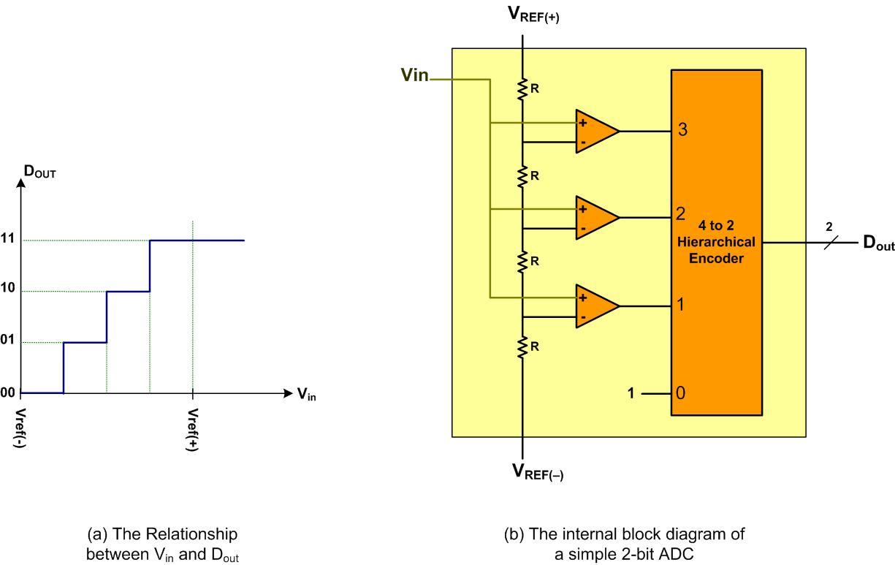
A Simultaneous 2-bit ADC

Slide 8
ADC parameters
Conversion time: Time it takes the ADC to convert analog value into digital
It is dictated by the clock source connected to the ADC
Analog input channels
Start conversion and end-of-conversion signals

Slide 9
Digital data output
Dout= vin/stepsize
Stepsize=vref/2^{n}
Example: 8 bit ADC , Vref = 2.56, vin =1.7, vout = 1.7/10mV = 170

Slide 10
Programming tm4c ADC

Slide 11
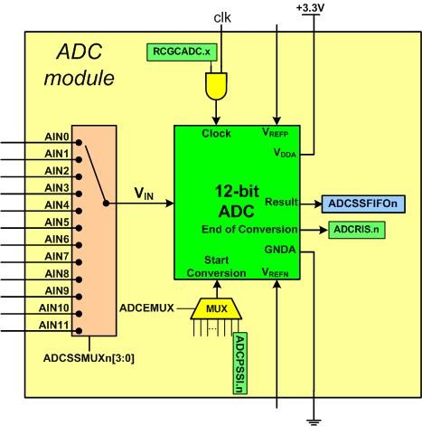
Simplified Block Diagram of a TI ADC Module
Notes:
2 on chip ADC modules
12 bit resolution
12 channels

Slide 12
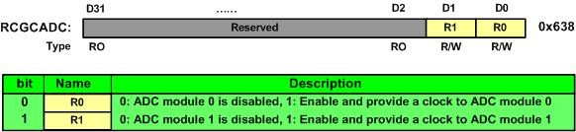
Enabling clock ADC Run Mode Clock Gating Control (RCGCADC)

Slide 13
The Sample Sequencer Samples and FIFO Depth of Sequencers
Sequencer | Number of Samples | Depth of FIFO
SS0 | 8 | 8
SS1 | 4 | 4
SS2 | 4 | 4
SS3 | 1 | 1
Notes:
4 sample sequencer
Each sequencer has its own size of fifo
Range 1 to 8
Default is ss3 , one sample, fifo with length 1

Slide 14
ADC Active Sample Sequencer (ADCACTSS)
Notes:
ASENx enables/disables SSx
SSx should be disabled before initiallizations

Slide 15
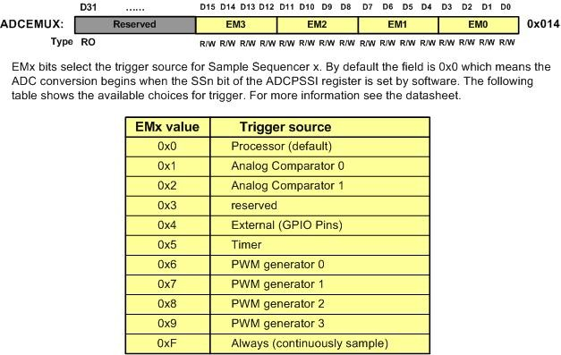
Start conversion trigger options ADC Event Multiplexer Select (ADCEMUX)
Notes:
These are start conversion options
Default is by software

Slide 16
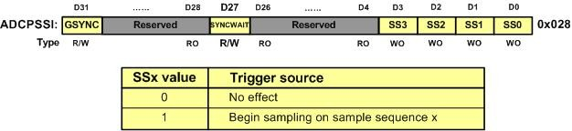
Begin Sampling on the chosen option ADC Processor Sample Sequence Initiate (ADCPSSI)

Slide 17
Analog input pin assignment in TI Tiva TMC123GH6PM
Pin Name | Description | Pin | Pin Number
AIN0 | ADC input 0 | PE3 | 6
AIN1 | ADC input 1 | PE2 | 7
AIN2 | ADC input 2 | PE1 | 8
AIN3 | ADC input 3 | PE0 | 9
AIN4 | ADC input 4 | PD3 | 64
AIN5 | ADC input 5 | PD2 | 63
AIN6 | ADC input 6 | PD1 | 62
AIN7 | ADC input 7 | PD0 | 61
AIN8 | ADC input 8 | PE5 | 60
AIN9 | ADC input 9 | PE4 | 59
AIN10 | ADC input 10 | PB4 | 58
AIN11 | ADC input 11 | PB5 | 57

Slide 18
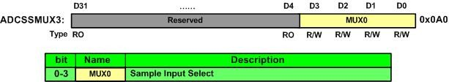
Selection of channel ADC Sample Sequence Input Multiplexer Select 3 (ADCSSMUX3)

Slide 19
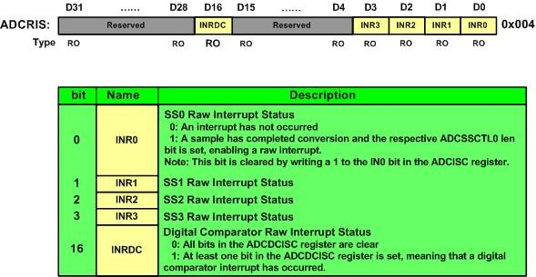
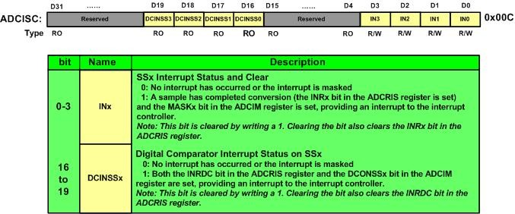
Polling or interrupt
End of conversion is indicated by flag bit in ADCRIS (ADC Raw Interrupt Status register)
Upon completion, respective pin goes high
This flag should be cleared before starting next conversion
It can be cleared by writing to ADCISC (ADC interrupt status and clear register)

Slide 20
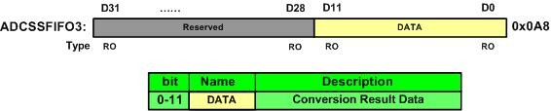
Output of ADC ADC Sample Sequence Result FIFOn(ADCSSFIFOn)
Each sample sequencer has its own FIFO
For SS3 following is used:

Slide 21
ADC channel pairing for differential
Differential Pair | Analog Inputs
0 | 0 and 1
1 | 2 and 3
2 | 4 and 5
3 | 6 and 7
4 | 8 and 9
5 | 10 and 11
We may need differences of two analog signals
TIVA tm4c has option of converting the differential voltage of two analog channels

Slide 22
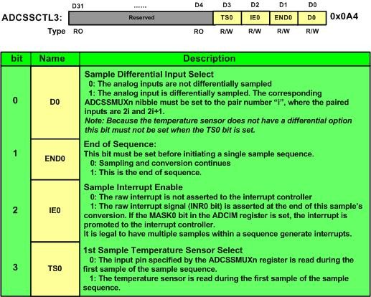
ADC Sample Sequence Control 3 (ADCSSCTL3)
Notes:
There is a temperature sensor

Slide 23
Overall Steps to configure ADC
Select channel
Do the configurations for that GPIO (remember to select alternate function and enable Analog function )
Select ADC module and enable clock for it
Select Sample sequencer
Do the configurations for that SS

Slide 24
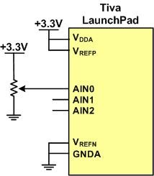
Example: Read value from AIN0 and display on PC

Slide 25
ADC init
/* enable clocks */
SYSCTL_RCGCGPIO_R |= 0x10; /* enable clock to GPIOE */
SYSCTL_RCGCADC_R |= 1; /* enable clock to ADC0 */
/* initialize PE3 for AIN0 input */
GPIO_PORTE_AFSEL_R |= 8; /* enable alternate function */
GPIO_PORTE_DEN_R &= ~8; /* disable digital function */
GPIO_PORTE_AMSEL_R |= 8; /* enable analog function */
/* initialize ADC0 */
ADC0_ACTSS_R &= ~8; /* disable SS3 during configuration */
ADC0_EMUX_R &= 0x0FFF; /* software trigger conversion val =0 */
ADC0_SSMUX3_R = 0; /* get input from channel 0 */
ADC0_SSCTL3_R |= 6; /* single ended, one conversion, raw interrupt*/
ADC0_ACTSS_R |= 8; /* enable ADC0 sequencer 3 */
while(1)
{
ADC0_PSSI_R |= 0x0008; /* start a conversion sequence 3 */
while((ADC0_RIS_R & 0x08) == 0) ; /* wait for conversion complete */
fvin=((ADC0_SSFIFO3_R&0xFFF) * 3.3) / 4096;
//read 12bit value from ADC0_SSFIFO3_R and do some processing
ADC0_ISC_R = 8; /* clear completion flag */
delayMs(1000);
}

Slide 26
Interfacing temperature sensors

Slide 27
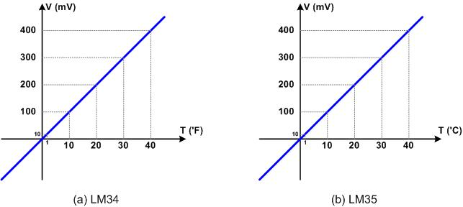
LM34 and LM35
Notes:
10mV / F
temperature = voltage / 10m

Slide 28
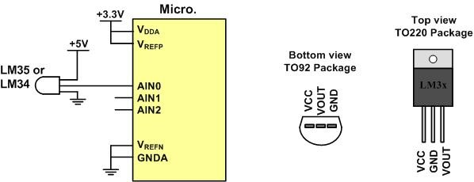
LM34/35 Connection to ARM and Its Pin Configuration

